Slide 1

ECE TA Workshop
May 15th, 2019

Slide 2
VE203
TA: 邱天宇

Slide 3

VE203
Course Workshop
by 邱天宇

Slide 4
Instructor & TAs
Course Intro
Contents
Suggestions & Tips

Slide 5

Part 1
Instructor & TAs

Slide 6

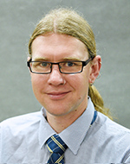
Instructor
Zachiri Mckenzi
Office: 441B@JI Building
Email: zachiri.mckenzie@sjtu.edu.cn
Comment:
Very reliable
Very helpful
Very modest

Slide 7
TAs
Qiu Tianyu
Email: qty2898734013@sjtu.edu.cn
Fan Zheliang
Email: sjtufzl@sjtu.edu.cn
Zhu Chenyu
Email: sofnfpfpfp@sjtu.edu.cn

Slide 8
Part 2
Course Intro

Slide 9
Beginning to Mid 1
Logic & Sets
Propositional Logic
Predicate Logic
Naive Set Theory

Slide 10
Beginning to Mid 1
Relations, Orders, Lattices & Functions
Relations
Orders
Lattices
Counting Sets
Fixed Points - TK Theorem

Slide 11
Beginning to Mid 1
Induction
Mathematical Induction
Structural Induction

Slide 12
Beginning to Mid 1
Binomial Theorem
Counting
Permutation & Combination

Slide 13
Beginning to Mid 1
Group Theory
Cycles
Order
Lagrange Theorem

Slide 14
Mid 1 to Mid 2
Congruency
Cayley Table
Linear Diophantine Equations
Euler’s Totient Function
Bézout’s Lemma
Euclidean Algorithm

Slide 15
Mid 1 to Mid 2
Congruency (Continue)
Chinese Remainder Theorem
Wilson’s Theorem

Slide 16
Mid 1 to Mid 2
Algorithm
Pseudocode
Search Algorithm
Sorting Algorithm
Time Complexity

Slide 17
Mid 2 to Final
Recurrence Relations
Linear Homogeneous Recurrence Relations
Inhomogeneous Linear Recurrence Relations

Slide 18
Mid 2 to Final
Sequences & Series
Divide & Conquer Algorithm
Generating Functions
Binomial Series

Slide 19
Mid 2 to Final
Graph Theory
Graph, Degree & Walk
Hamilton Path
Shortest Path Problem
...

Slide 20
Part 3
Suggestions & Tips

Slide 21
Suggestions & Tips
Materials to refer to:
Lecture Slides (Important!)
<<Discrete Mathematics and Its Applications>>
Ability to be examined:
Ability to Construct (Important!)
Ability to make applications
How to learn VE203 well:
Understand all examples in the slides
Understand (then memorize) all Theorem
& their proofs

Slide 22
Suggestions & Tips
Treat assignemnts seriously:
Think carfully over every question
Exams will have similar difficulty
Try to use latex
Practice More!
Exam time is limited.

Slide 23
Q & A

Slide 24
VE270
TA: 刘倪逸秋

Slide 25
VE270 Intro. to Logic Design

Slide 26
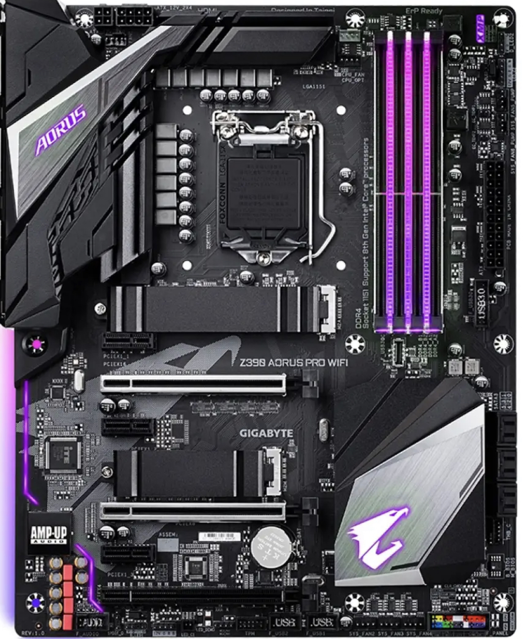
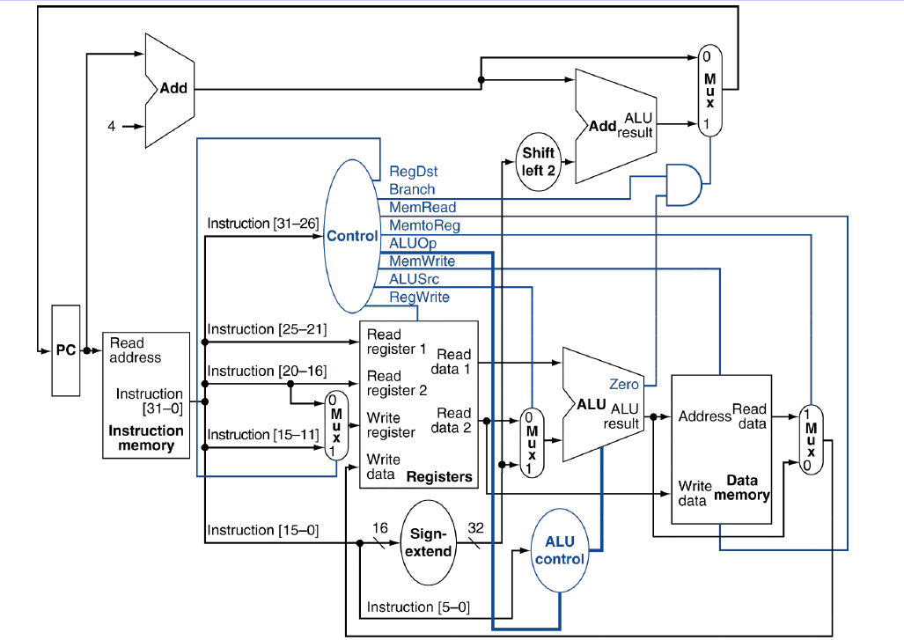
Overview
Notes:
What is logic circuit? A good example would be a computer.
Motherboard: AC power, digital signals, cpu, components of cpu

Slide 27
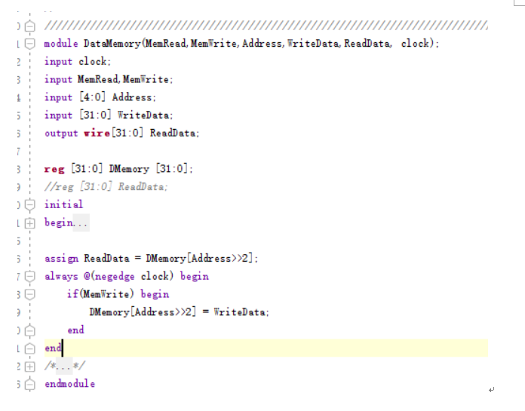
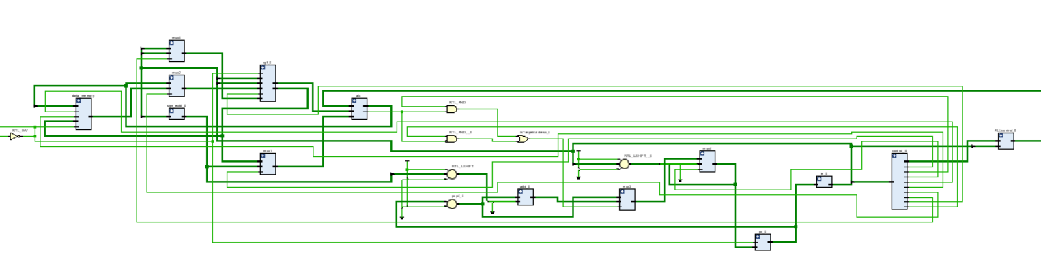
Lab – Verilog
Notes:
CAD

Slide 28
Notes
Late homework submission is not accepted
Start early for each lab
Stay focus during lecture time
Notes:
Three lowest homework scores are discarded. Be on time.
Labs can be flexible. Have fun at the labs
This course won’t cost you much time.

Slide 29
VE280
TA: 刘逸灏

Slide 30
VE311
TA: 刘祖衡

Slide 31
VE300
TA: 郑思仪

Slide 32

LOGO
VE300
郑思仪

Slide 33
LOGO
VE300
1.
格式

Slide 34
LOGO
VE300
2.
准确

Slide 35
LOGO
VE300
3.
衔接

Slide 36
LOGO
VE300
4.
查重

Slide 37
VE401
TA: 郭凌云

Slide 38
Ve 401
Contents
Tips

Slide 39


What is Ve 401 about?
Probability
Statistics

Slide 40
Tips
Read slides
Do homework by yourself
Do sample exam individually
Visualization

